Slide 1



UNIT 4
LESSON 13
Living online
Part 5

Slide 2
It doesn’t matter if they are big or small, nobody’s happy to have them.
You want to know if it’s best to ignore them.
That’s a bad idea because then they get even worse.
Instead, you should face them and find a way to solve them.
Sometimes you can’t deal with them on your own.
It’s OK to ask for help.
Don’t be embarrassed.
Turn to your family or friends.
If they are related to school, discuss them with your teachers.
I bet you know what I’m talking about.
They are
PROBLEMS.

Slide 3
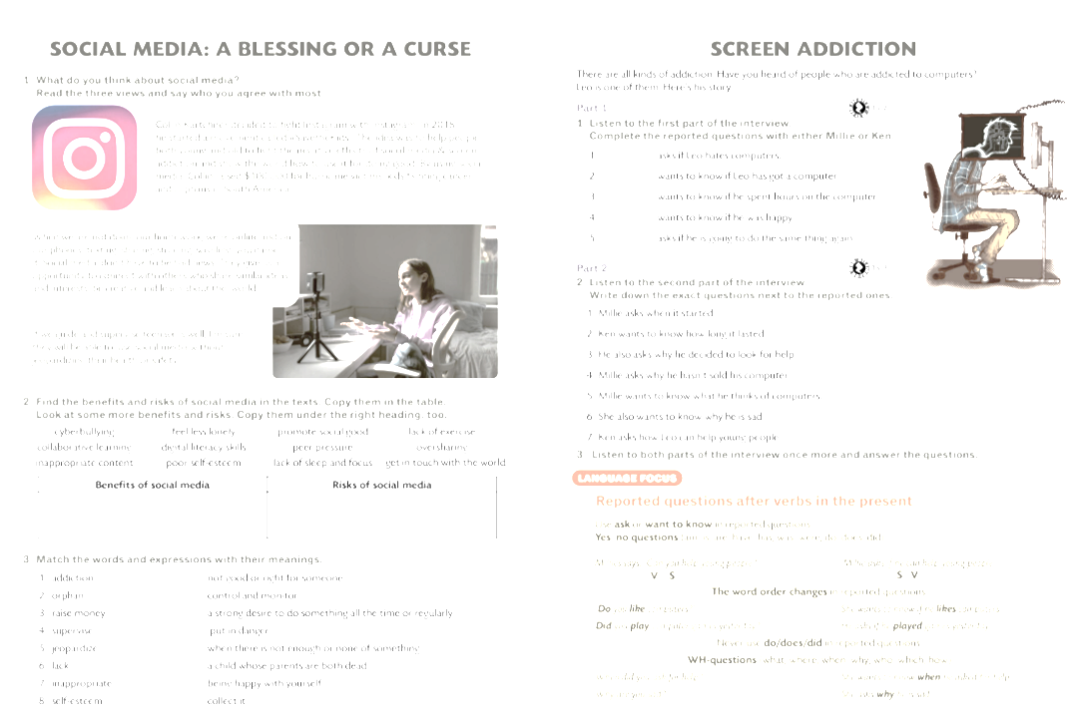


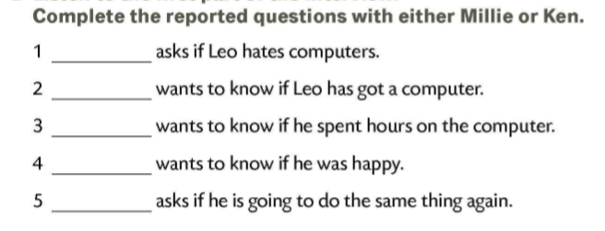
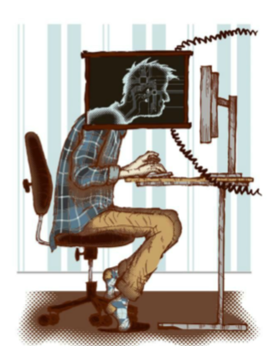
Ken
Ken
Millie
Ken
Millie

Slide 4
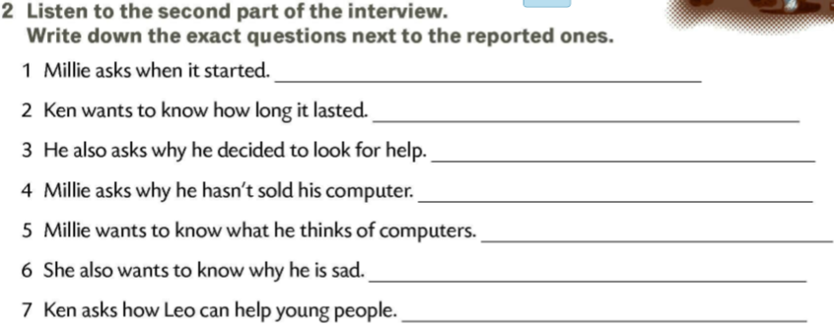
When did it start?
How long did it last?
Why did you decide to look for help?
Why haven’t you sold your computer?
What do you think of computers?
Why are you sad?
How can you help young people?

Slide 5
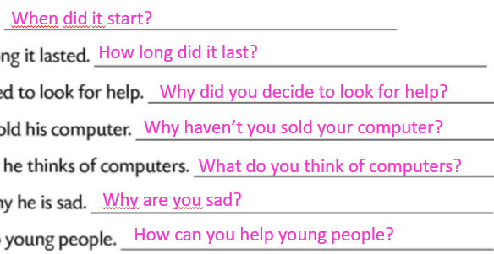
He was 13 years old.
He would spend hours in a chat room for about a year.
His mum did because he couldn’t sleep or eat.
Because he needs it.
He thinks they are great. They are very useful.
Because nobody believes him that computer addiction is a serious problem.
By telling his story.

Slide 6
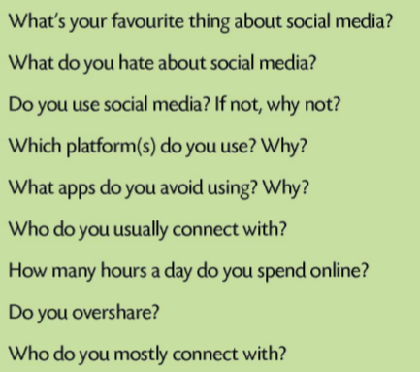
How good are you at memorising questions?

Slide 7
Suggested steps:
a First, elicit the ideas describing the advantages and disadvantages of social media. Write them all on the board.
b Divide the class into two groups. Allocate roles to the groups (For/Against groups).
c Choose a chairperson, a student, to chair the discussion. The chairperson has to introduce the topic and check that the groups take turns to give arguments for or against it.
d Give the two groups some time to decide which statements they are going to use and in which order. They can also try to come up with some more ideas that are not on the board which could give them an advantage over the other group. The chairperson also prepares to say a few sentences before the debate starts.
e Have a class debate.

Slide 8
USEFUL LANGUAGE
For the chairperson Today we will talk about computers and the Internet because... We will discuss their good and bad points. Please listen to each other. Do not interrupt, but take turns. Let’s start. Can I ask Group A to start?
Giving opinion In my opinion.../ I think that.../ Let me say this...
Giving an example Let me give you an example
Emphasising I’d like to point out...
Agreeing/Disagreeing I agree with.../ I also think that... I disagree with.../ I don’t think that...
Who was more convincing and who won the debate?

Slide 9
